Slide 1
Do Now - Matching
Match each term (A-D) with the correct definition (1-4):
TERMS
1. A detailed design of table structure (fields & data types), relationships and constraints.
A. Database Schema
?
2. Represents the implementation of the logical schema in a specific DBMS, showing how data is stored, indexed or accessed.
B. Conceptual Schema
?
3. An abstract model describing the structure of data without considering physical implementation.
C. Logical Schema
?
D. Physical Schema
?
4. it uses rules and constraints to maintain data accuracy and consistency, showing how data is organised and how the relationship between data is managed.
E. Data Integrity
?
5. An architecture showing how data is organised and how relationships between data are managed.
Write number here

Slide 2
Do Now - Matching
Match each term (A-D) with the correct definition (1-4):
TERMS
1. A detailed design of table structure (fields & data types), relationships and constraints.
A. Database Schema
4
2. Represents the implementation of the logical schema in a specific DBMS, showing how data is stored, indexed or accessed.
B. Conceptual Schema
3
3. An abstract model describing the structure of data without considering physical implementation.
C. Logical Schema
1
D. Physical Schema
2
4. it uses rules and constraints to maintain data accuracy and consistency, showing how data is organised and how the relationship between data is managed.
E. Data Integrity
4
5. An architecture showing how data is organised and how relationships between data are managed.
Write number here

Slide 3
Lesson 2 DB Design
T Myran

Slide 4
L2 - Syllabus Links
A3.2.1 Describe database schemas.
Conceptual schema, logical schema, physical schema
Abstract definitions of the data structure and organisation of the data at different levels
A3.2.3 Outline the different data types used in relational databases.
The importance of data type consistency
The potential effects of choosing the wrong data type

Slide 5
Lesson 2 Design schemas and Datatypes
Describe different database schemas
Identify several data types used in database
Evaluate the benefits and drawbacks of different database schemas

Slide 6
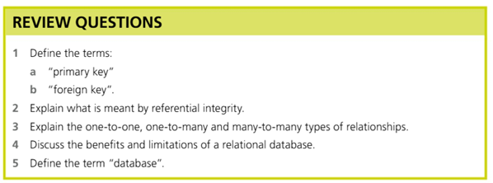
Quick Review on last lessons learning…

Slide 7
Review
1. Define the terms:
a) Primary Key: A field (or set of fields) in a table that uniquely identifies each record. It must be unique and cannot contain null values.
b) Foreign Key: A field in one table that references the primary key of another table, creating a link between the two tables to establish a relationship.
2. Explain what is meant by referential integrity.
Referential integrity is a database rule that ensures relationships between tables remain consistent. It means a foreign key value must always correspond to an existing primary key value in the referenced table. For example, you cannot add an order for a customer ID that doesn't exist in the Customers table, and you cannot delete a customer who still has orders referencing them.

Slide 8
Review
3. Explain the one-to-one, one-to-many and many-to-many types of relationships.
One-to-one: Each record in Table A is related to exactly one record in Table B, and vice versa. (e.g., one employee has one employee record)
One-to-many: One record in Table A relates to many records in Table B, but each record in Table B relates to only one record in Table A. (e.g., one customer places many orders)
Many-to-many: Records in Table A can relate to many records in Table B, and vice versa. (e.g., students and courses). This requires a junction/link table to implement in a relational database.

Slide 9
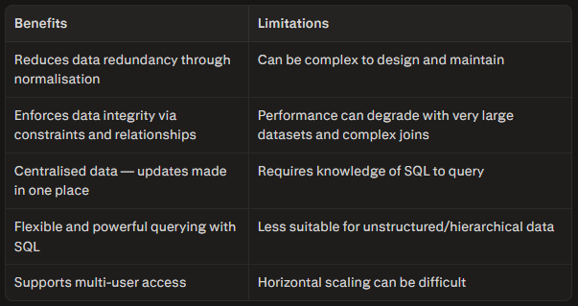
Review
5.
A database is an organised collection of structured data stored electronically and managed by a Database Management System (DBMS).
Allows data to be efficiently stored, retrieved, updated, and deleted.
A relational database specifically organises this data into tables (relations) with defined relationships between them.
4.

Slide 10
Conceptual Schema
a high-level representation of the database, defining its structure and organisation.
It is an abstract model that hides details such as implementation of the data structure
A common method of implementing conceptual schema is by using entity-relationship diagrams (ERDs).

Slide 11
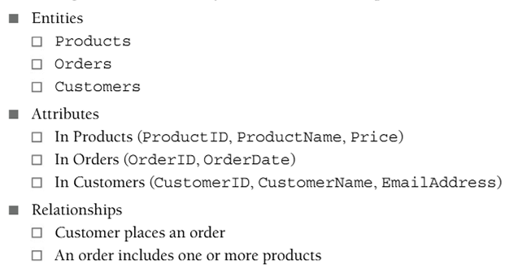
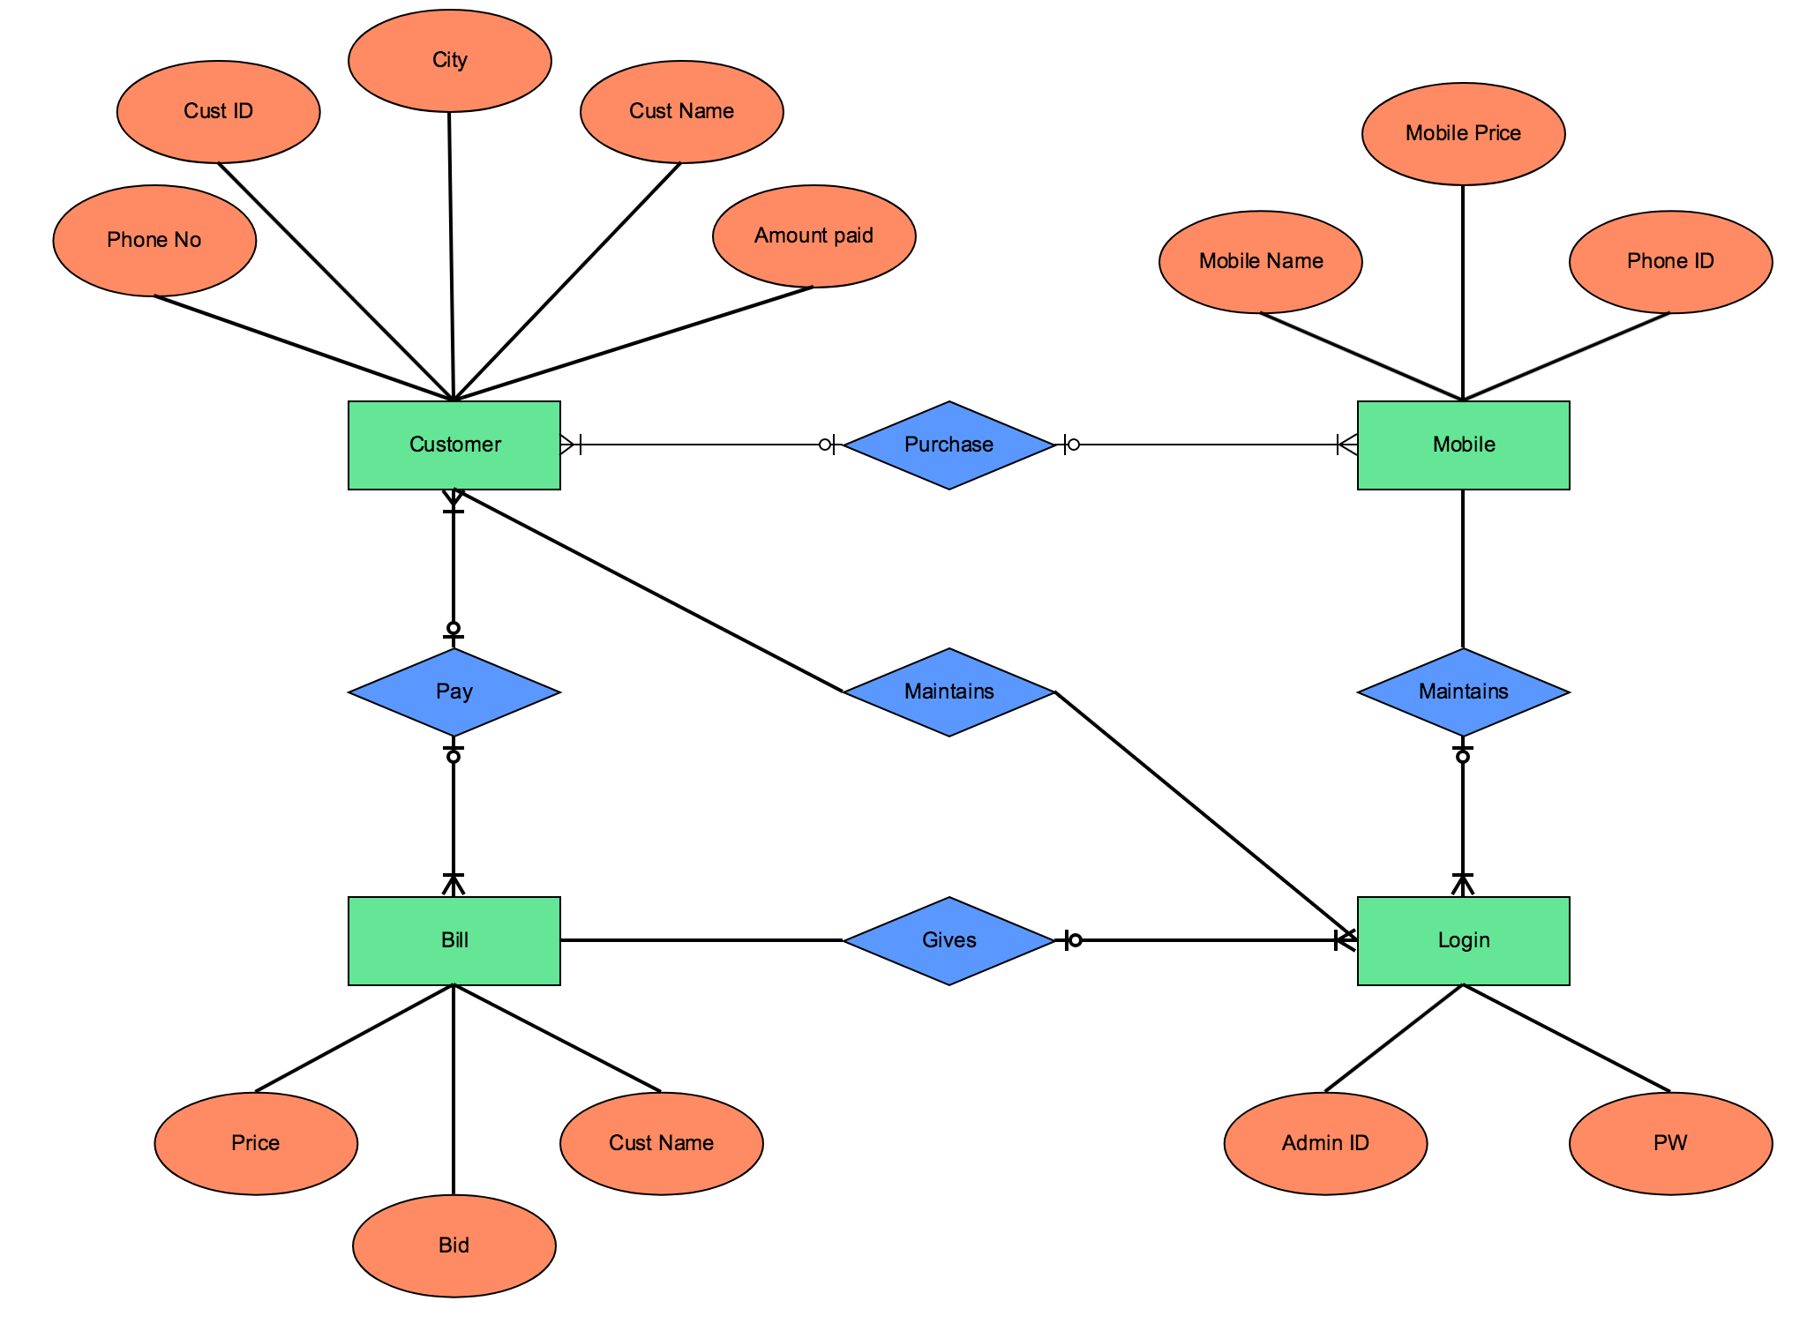
ERD - Entity Relationship Diagram
Knowledge Check: How many tables will the above example require?

Slide 12
Logical Schema
a model that defines the structure of the database, including entities, attributes, data types, constraints, keys (primary/foreign) and relationships.
doesn't take into consideration the requirements of a specific database management system (DBMS).
is derived from the conceptual schema by..

Slide 13
…
converting the entities into detailed tables
defining the attributes by specifying the data types and constraints for each field in the table
establishing primary and foreign keys
defining relationships between the tables by using the keys
normalising the database to minimize data redundancy
ensuring data integrity.

Slide 14
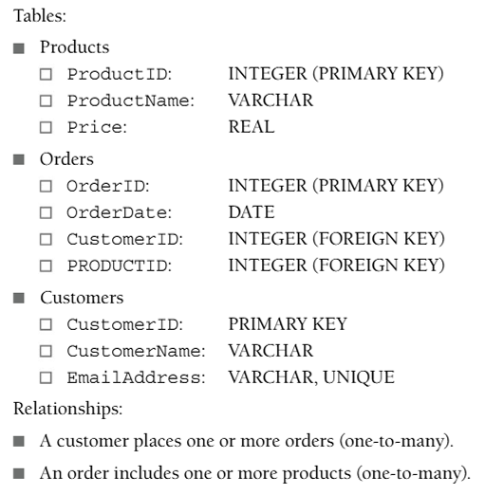
Questions
How many tables?
How many attributes in Orders?
What is CustomerID?
What datatype is Price?
What are CustomerID and PRODUCTID in the Orders table
Describe the EmailAddress field

Slide 15
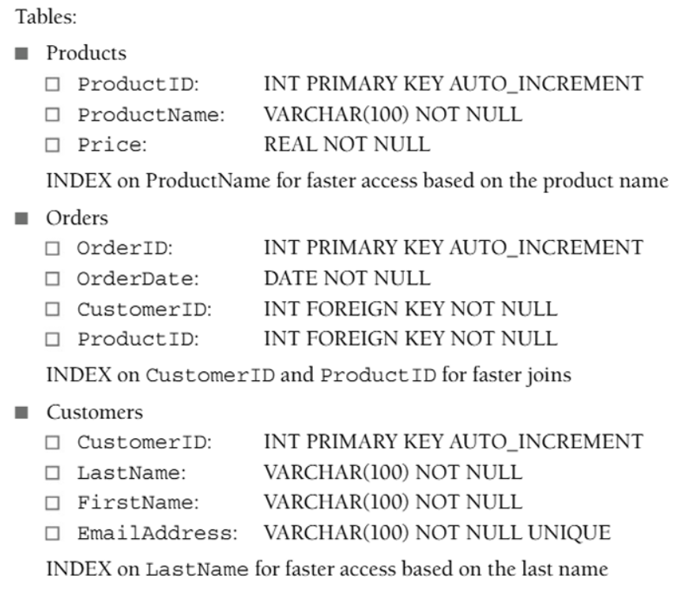
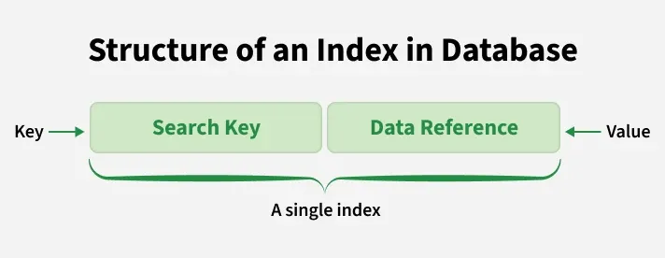
Physical Schema
Shows how a specific DBMS system stores the data
It will refer to specifics of storage device, access method, indexes, partitions and views

Slide 16
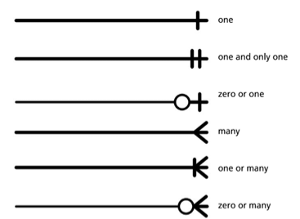
Relationships & ‘Modality’
Modality (minimum)
Modality in an ERD tells you the minimum number of times one entity must take part in a relationship.
It answers: “Is this relationship optional (0) or mandatory (1) for this entity?”
Examples:
Hospital system: A patient might not have any medical records yet (new patient or newborn), so medical records are optional for a patient (modality 0).
E‑commerce: Every order must be linked to a customer, so the customer in the order–customer relationship is mandatory (modality 1).

Slide 17
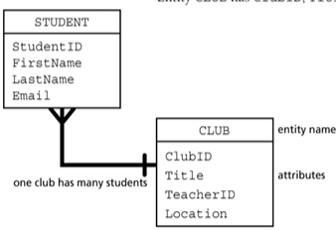
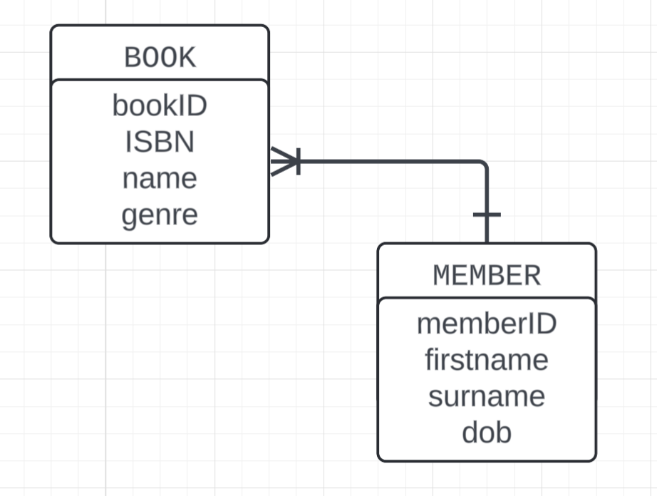
Task: Create your own DB struct.
A library system has books and members. Using the diagram on the right for assistance, create a two table ERD with an appropriate relationship/modality to represent a member being able to loan out book(s)
EXT: add a third table for borrow

Slide 18
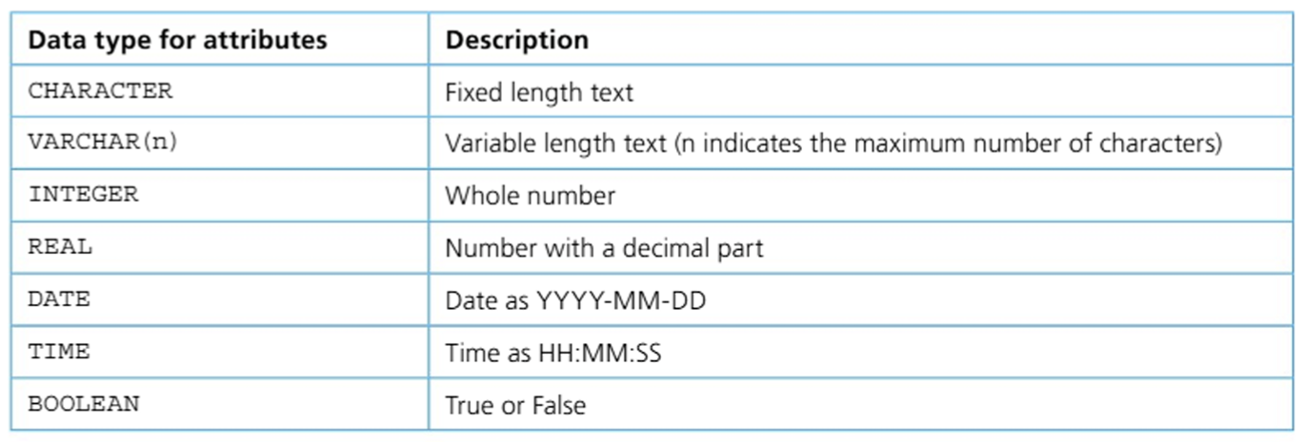
A3.2.3 Data types used in relational databases
Word Bank: Boolean, Time, Date, Integer, VarChar, Real
Can you guess the missing sections?

Slide 19
A3.2.3 Data types used in relational databases
See if you can complete the table yourself first…

Slide 20

Picking the right type
Choosing the right data type helps the database work faster and avoid errors. It affects how data is stored, what operations are allowed, and whether the same data stays consistent across systems.
​
Pick the correct data type so the database can:
Store data efficiently.
Run queries quickly.
Do calculations correctly.
Keep data consistent between database and applications.
​

Slide 21

1. Efficiency and speed
Fixed-length types (like CHARACTER(8)) are faster to index and search than variable-length types (like VARCHAR(8)) for data that is always the same length (for example, UserID). Using VARCHAR in this case can make queries slower.
​
Efficient data types help the database handle large amounts of data without wasting space or time.

Slide 22
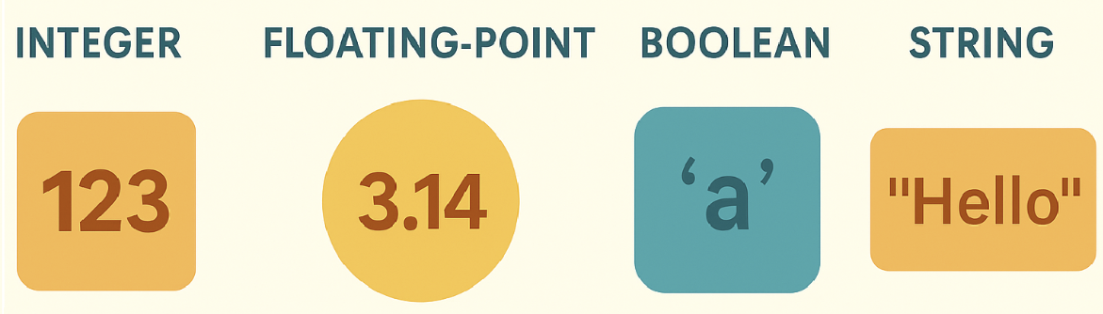
​2. What operations are allowed
The data type decides what you can do with the data. For example, if quantity and price are stored as text, you cannot calculate totals directly in the database.
​
To do calculations, the application must first convert the text to integer or real numbers, which adds extra work and complexity.

Slide 23
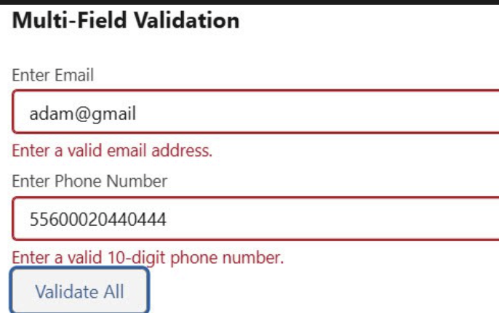
3. Avoiding errors when inserting data
The value you insert must match the field’s data type, or the database will reject it and show an error.
​
Using appropriate data types ensures that data can be stored correctly in the right fields.

Slide 24
4. Data consistency across systems
Data consistency means all copies of the data are accurate and up to date across all tables and systems.
​
If different systems (database vs application) use different data types for the same attribute, problems can happen, such as not being able to use certain operations.

Slide 25
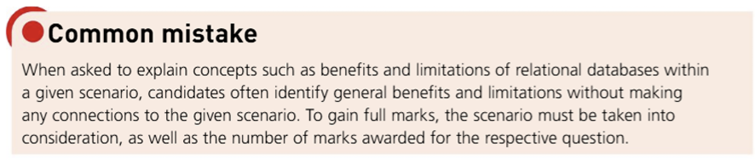
Remember, when answering questions

Slide 26

Independent Work
It’s your turn. Work through your booklet starting with Section A and moving through to Section B
Section C is a reflection and extension section. Only complete the extension if you finished all other tasks. Complete the evaluation at the end of the lesson, or at home.

Slide 27
Plenary:
⭐ Exit Ticket:
On a scale of 1-5, how confident are you in identifying and applying the correct data types and schemas in a relational database?
1 □ 2 □ 3 □ 4 □ 5 □
1. Name the 3 types of database schemas.
2. What does a conceptual schema show? Give an example of how it is represented.
3. What is a logical schema derived from, and what does it define?
4. Name 4 data types used in relational databases.
5. Why is choosing the correct data type important? Give TWO reasons.
6. A field stores a product price such as 9.99 — which data type should be used?
7. What is the difference between CHAR and VARCHAR?

